Slide 1

Final Project Report
EGI 12 Predictive Maintenance
Reported by 8A Group

Slide 2






Meet our team
Ayub Indra Data Analyst
Diana Afiifah Data Analyst
Ichfan Kurniawan Data Engineer
Ilham Kurniawan Data Analyst
Luthfi M. Irsyad Data Engineer
Gibran Brahmanta Data Scientist

Slide 3
Contents
Problem
Challenge
Solution

Slide 4
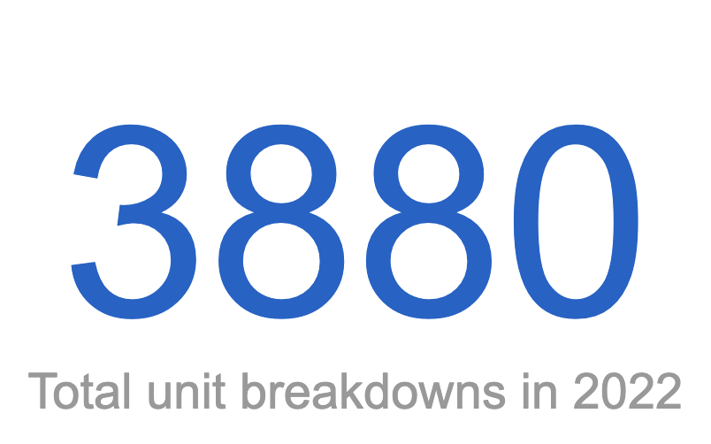
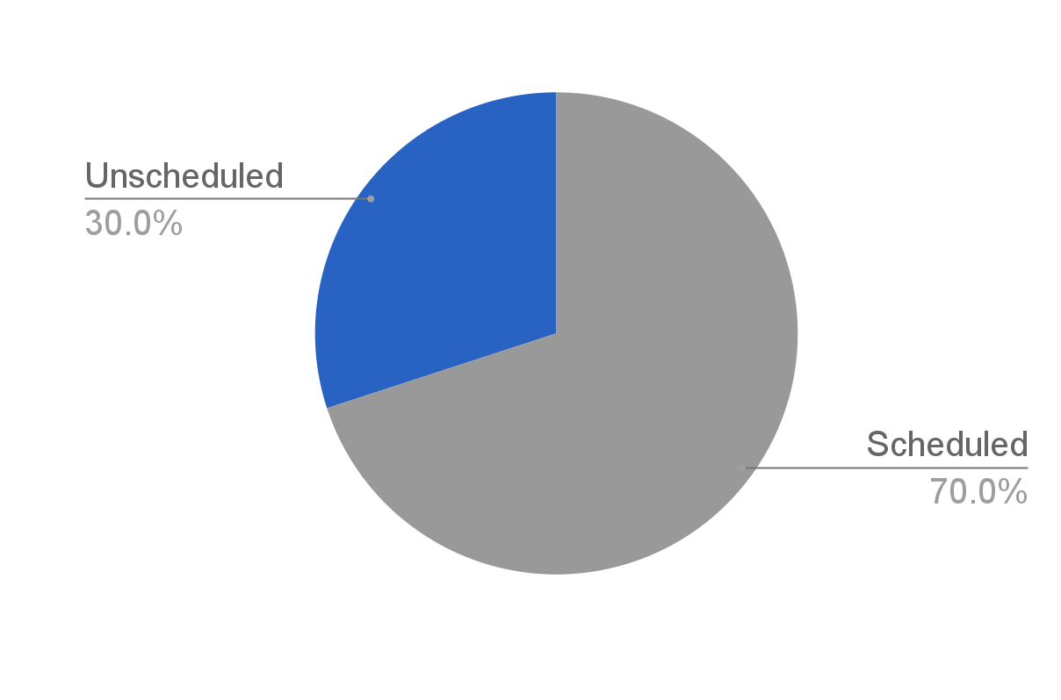
Problems (1/3)
Unscheduled maintenance caused by unit breakdowns might put PT. Hasnur Riung Sinergi cost efficiency at risk
Source: Daily Breakdown Dataset, Hasnur Riung SInergi, 2022. Supplementary descriptive data are provided in EGI 12 Predictive Maintenance dashboard.

Slide 5
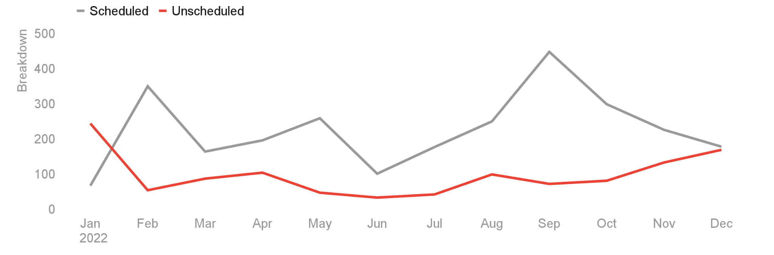
Problems (2/3)
Unscheduled maintenance constantly occurred throughout the year, where January marked the highest one
Source: Daily Breakdown Dataset, Hasnur Riung Sinergi, 2022. Supplementary descriptive data are provided in EGI 12 Predictive Maintenance dashboard.

Slide 6
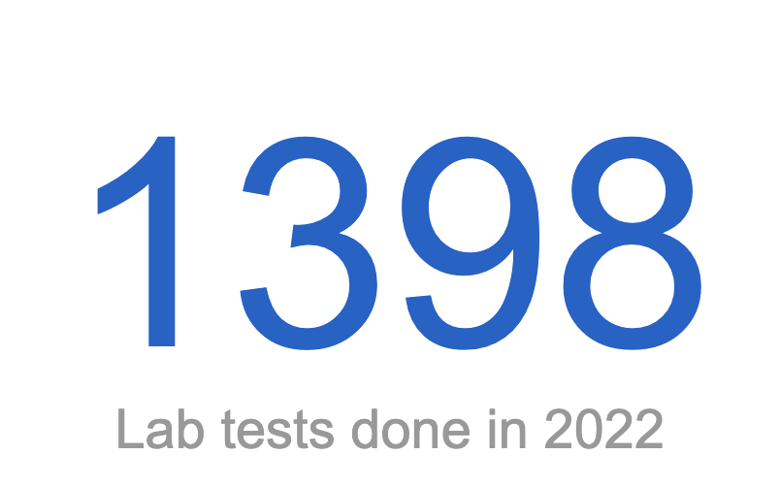
Problems (3/3)
Unscheduled maintenance occurred despite periodic oil analysis aimed at monitoring lubricant and machine condition
Metal tested
Al | Cr | Cu
Fe | Na | Pb
Si | PQI | V100
Source: Oil Dataset, Hasnur Riung Sinergi, 2022. Supplementary descriptive data are provided in EGI 12 Predictive Maintenance dashboard.

Slide 7
Contents
Problem
Challenge
Solution

Slide 8
Project difficulties
Inconsistent data due to manual entry
Unformatted and unstructured data
Outdated Telematics data
Notes:
free resources

Slide 9
Contents
Problem
Challenge
Solution

Slide 10



Our key solutions
Create a data pipeline to improve data quality and analytics workflow
Implement a machine learning prediction model for predicting current machine health
Create a real-time analytics dashboard to enhance data insights

Slide 11
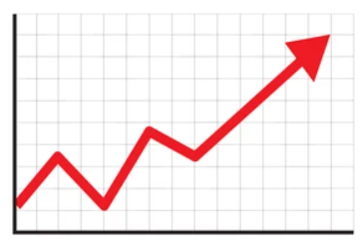






Automatic & cloud based data pipeline to ease & lean the overall process
Data Sources
Download
Data Warehouse
Live Connections
Cleaning & Load
Prediction / Modelling
Excel File
Live Connections
Transformation
Analytics Dashboards
Extract & Load
Transform
Analysis

Slide 12

Three areas inside bigQuery (data warehouse)
The Data marts are the areas to be consumed by the Data Scientist and Data Analyst
Data Mart Data Scientist (Prediction / Modelling)
Raw Data
Data Warehouse
Data Mart Data Analyst ( Analytics Dashboards)

Slide 13
The prediction overview
Objective
Methodology
Benefit
Predicting current machine health based on oil sampling result
Using regression model to predict the hours meter
Maximizing MTBF value to minimize cost efficiency risk for the business

Slide 14
Machine components are being grouped into three groups
In order to create better performance, because there were differences on each component mineral content
Group 1 | Group 2 | Group 3
Differential Rear, Final Drive Rear Left | Engine, Hydraulic System, Steering System, Torque Converter Housing, Torque Converter Divider, Transfer Gears, Transmission, Transmission Power Shift, Wheel Bearings Front Left, Wheel Bearings Front Right | Final Drive Left, Final Drive Rear Right

Slide 15
There were differences related to model specification
Every group have it’s own model specification to gain the best performance
 | Group 0 | Group 1 | Group 2
Model | XGBoost | Random Forest | XGBoost
Estimators | 200 | 50 | 200
Depth | 50 | 50 | 50

Slide 16
Model performance were being very accurate on Group 0 & 2, but have bigger loss on Group 1
Evaluation Metrics | Group 0 | Group 1 | Group 2
RMSE | 3377.60 | 5721.59 | 482.94
MAE | 1506.46 | 4684.01 | 362.98
RMSE : Root Mean Squared Error
MAE : Mean Absolute Error
Click here to see the details

Slide 17
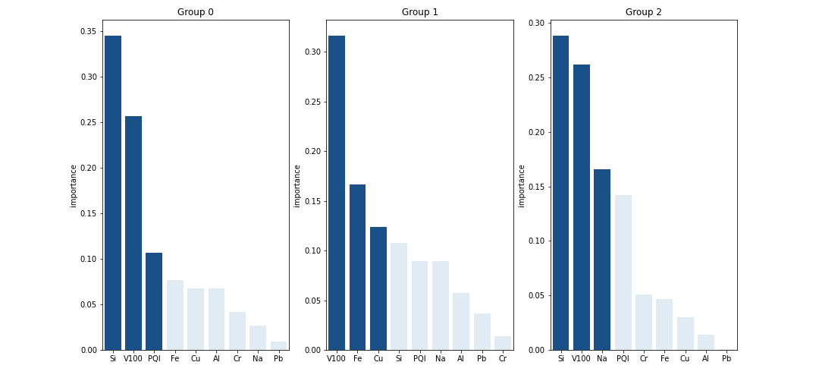
There were differences in top-3 most influential metal on each group
V100 and Si are dominantly giving the effects in the three groups

Slide 18
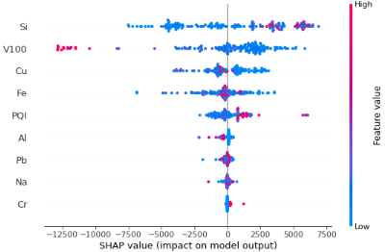
Interpretability - Group 0
Key Insight:
High amount V100 content in oil can reduce oil meter +/- 12.500. Meanwhile, low amount V100 content can increase oil meter 2500 - 5000

Slide 19
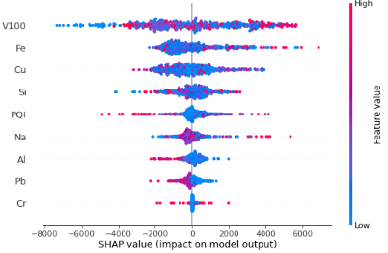
Interpretability - Group 1
Key Insight:
Low amount V100 content in oil can reduce oil meter 4000 - 8000. Meanwhile, high amount V100 content can increase oil meter 4000 - 6000

Slide 20
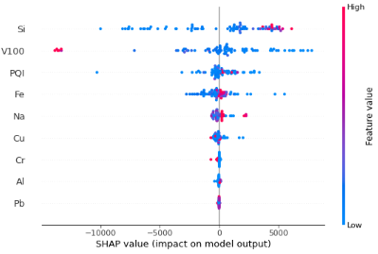
Interpretability - Group 2
Key Insight:
High amount V100 content in oil can reduce oil meter >10000. Meanwhile, low amount V100 content can increase oil meter >= 5000

Slide 21
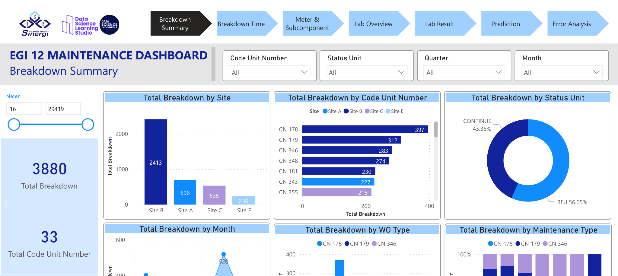
Time to demo with dashboard
Source: Page 1: Breakdown Summary

Slide 22
What’s next?
2023 - Q2
2023 - Q3
2023 - Q4
2024 - Q1
Create standardization for data input
Implement data pipeline on higher level
Doing research related to current machine health prediction
Exploratory Data Analysis for modeling
Modeling for all of machine types (Not only EGI 12)
Creating dashboard
Maintain and improve data pipeline
Create machine learning infrastructure
Machine learning model deployment
Add model result into dashboard
Maintain and improve data pipeline
Model performance monitoring
Re-training model (if needed)
Dashboard monitoring
End-to-end pipeline improvement

Slide 23
Thank you

Slide 24
Appendix
User Guideline
Model
Folder
Inference Notebook
Retraining Notebook
Includes all info related to output
Reusable modeling result
Interface to predict current machine health
Can be used if model not being accurate anymore
Note: Documentation regarding the items can be accessed on the designated link

Slide 25


Notes:
Closing

